Slide 1
Unit-3
Cont…

Slide 2
Multivalued Dependency
Multivalued dependency occurs when two attributes in a table are independent of each other but, both depend on a third attribute.
A multivalued dependency consists of at least two attributes that are dependent on a third attribute that's why it always requires at least three attributes.

Slide 3
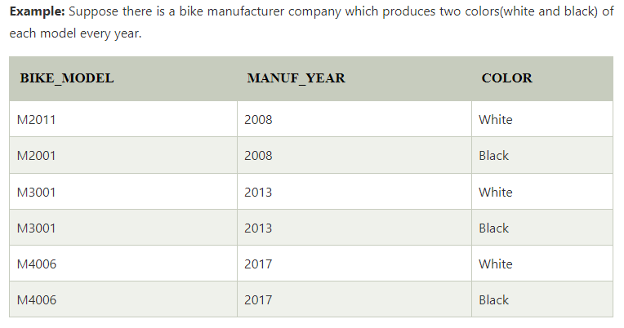
Here columns COLOR and MANUF_YEAR are dependent on BIKE_MODEL and independent of each other.
In this case, these two columns can be called as multivalued dependent on BIKE_MODEL. The representation of these dependencies is shown below:
BIKE_MODEL → → MANUF_YEAR
BIKE_MODEL → → COLOR

Slide 4

4NF
Any relation is said to be in the fourth normal form when it satisfies the following conditions:
It must be in Boyce Codd Normal Form (BCNF).
It should have no multi-valued dependency.

Slide 5
Join Dependency
Join decomposition is a further generalization of Multivalued dependencies. If the join of R1 and R2 over C is equal to relation R then we can say that a join dependency (JD) exists, where R1 and R2 are the decomposition R1(A, B, C) and R2(C, D) of a given relations R (A, B, C, D).
Alternatively, R1 and R2 are a lossless decomposition of R. A JD ⋈ {R1, R2, …, Rn} is said to hold over a relation R if R1, R2, ….., Rn is a lossless-join decomposition.
The *(A, B, C, D), (C, D) will be a JD of R if the join of join’s attribute is equal to the relation R.
Here, *(R1, R2, R3) is used to indicate that relation R1, R2, R3 and so on are a JD of R.

Slide 6
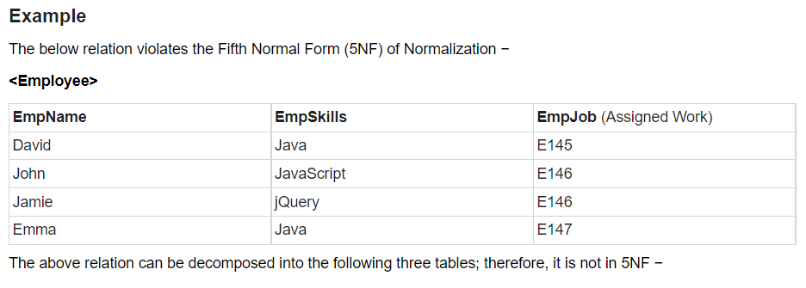
5NF
A relation is in Fifth Normal Form (5NF), if it is in 4NF, and won’t have join dependency.
You can also consider that a relation is in 5NF, if the candidate key implies every join dependency in it.

Slide 7
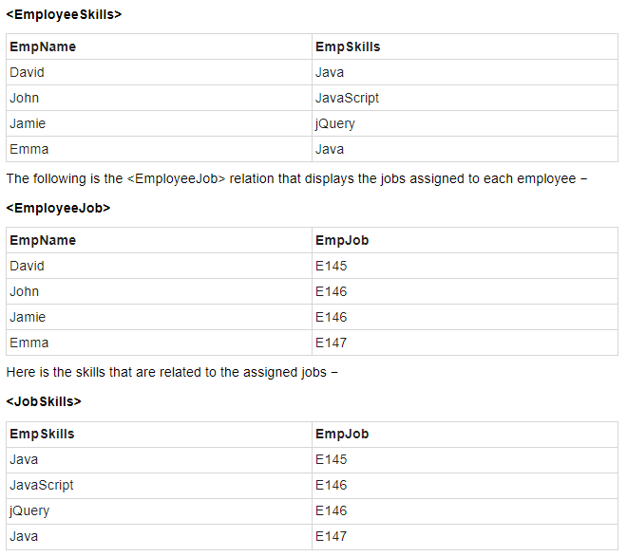

Slide 8
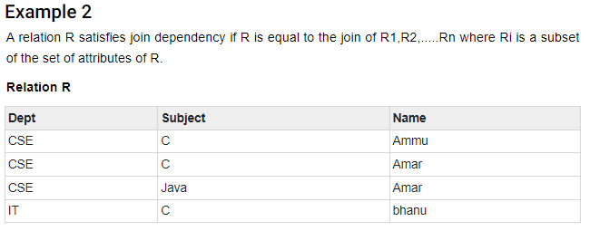
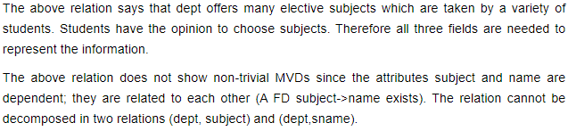

Slide 9
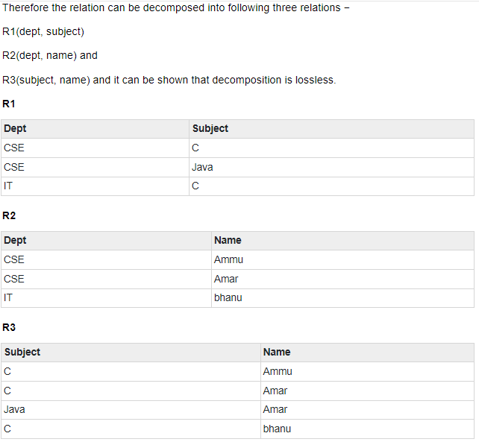

Slide 10
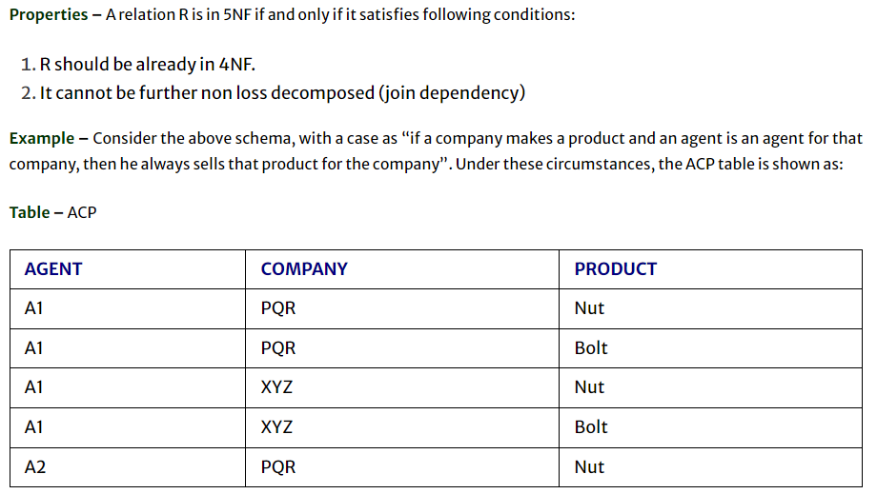
EXAMPLE - 3

Slide 11
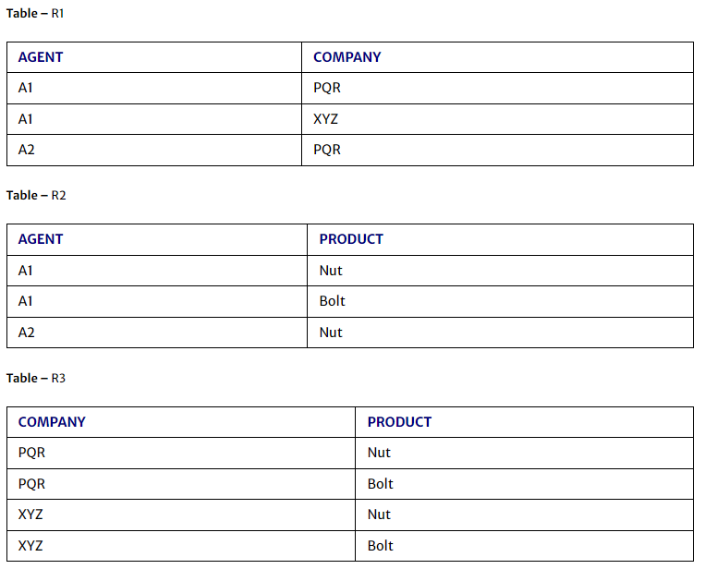
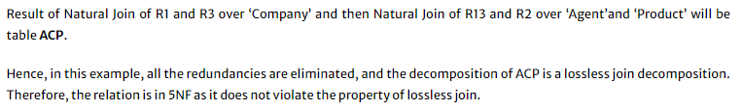

Slide 12
